Slide 1
MAGIC or Machine Learning? Classifying Simulated Cherenkov Radiation Telescope Observations
Ethan Davis, Luis Diaz, Jonathan Gates

Slide 2
Presentation Overview
Problem Background
Introduction to the Dataset, Preprocessing
Method 1: Support Vector Classifier
Method 2: Random Forest
Method 3: Neural Network
Comparison of Method Results
Conclusions
Acknowledgements
Appendix of Variables

Slide 3
Problem Statement and Dataset

Slide 4
What is MAGIC?
Major Atmospheric Gamma Imaging Cherenkov Telescopes
Cherenkov radiation are photons emitted by charged particles when traveling faster than the speed of light in their current medium—analogous to sonic booms caused by supersonic travel
MAGIC detects the Cherenkov radiation emitted in particle showers caused by gamma rays from astrophysical objects

Slide 5
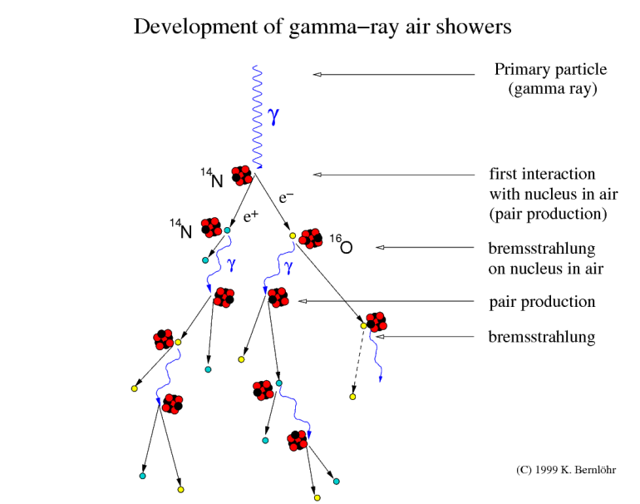
Particle Showers
Cascading showers of particles caused by interactions between incoming gamma rays and atmospheric nuclei
Particle showers can be also caused by cosmic rays, which are massive particles or nuclei
Differentiation between the two types of showers is difficult—can machine learning help?
Image Credit: K. Bernlöhr, Max Planck Institute for Nuclear Physics

Slide 6
Dataset Overview
The data is produced by CORISKA, a Monte Carlo program that simulates the registration of particle showers in a Cherenkov radiation telescope
The image of a shower is an elongated elliptical cluster; the dataset contains 10 variables describing characteristic parameters of this ellipse and 1 describing the class
Total of 19,020 samples; 12,332 are gamma rays (signal), 6,668 are cosmic rays (background)
This class imbalance does not reflect reality, cosmic rays represent most observed events
Simple accuracy (percentage of events correctly classified) is not useful, dataset publishers recommend Receiver Operating Characteristic curves
Publishers also note that false negatives are preferable to false positives

Slide 7
Data Preprocessing
Because the dataset was created by simulation, the data is clean and complete and requires minimal preprocessing
We applied scikit-learn’s StandardScaler, which scales the data such that each variable has mean 0, standard deviation 1, and returns the resulting z-score for each datapoint
For all methods, the data was split so that 2/3 was used for training and 1/3 for testing

Slide 8
Assumptions and Justifications
Nearly all statistical models assume that samples are IID
SVC: no further assumptions
Random Forest: assumes its samples are representative (built on bootstrapping), does not make assumptions about IID
Neural Networks: no further assumptions
We justify the assumption of IID by noting that all samples are produced by the same Monte Carlo simulation of the same physical processes

Slide 9
Methods

Slide 10
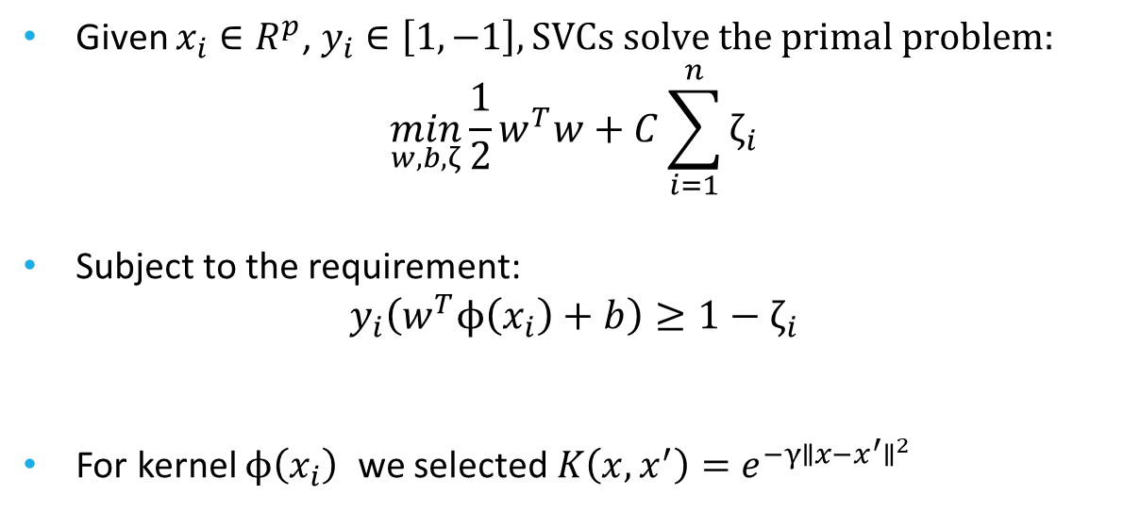
Support Vector Classifiers
Given $x_{i}∈R^{p}$, $y_{i}∈\left[1,−1\right], SVCs solve the primal problem:$
$$\min_{w,b,ζ}\frac{1}{2}w^{T}w+C\sum_{i=1}^{n}{ζ_{i}}$$
Subject to the requirement:
$$y_{i}\left(w^{T}ϕ\left(x_{i}\right)+b\right)≥1−ζ_{i}$$
For kernel $ϕ\left(x_{i}\right)$ we selected $K\left(x,x^{′}\right)=e^{−γ∥x−x^{′}∥^{2}}$

Slide 11
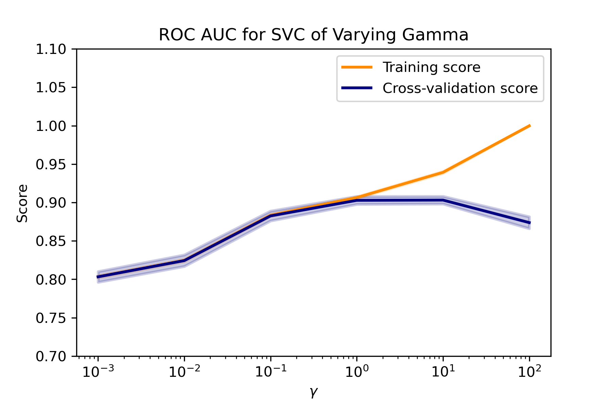
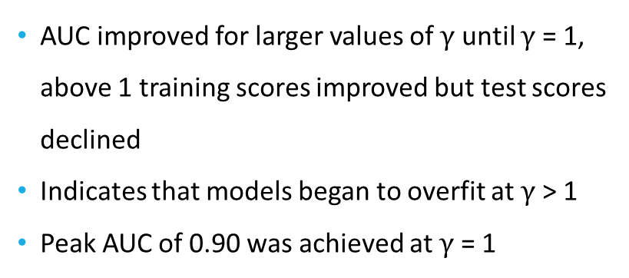
ROC AUC Values for SVCs
AUC improved for larger values of $γ$ until $γ$ = 1, above 1 training scores improved but test scores declined
Indicates that models began to overfit at $γ$ > 1
Peak AUC of 0.90 was achieved at $γ$ = 1

Slide 12
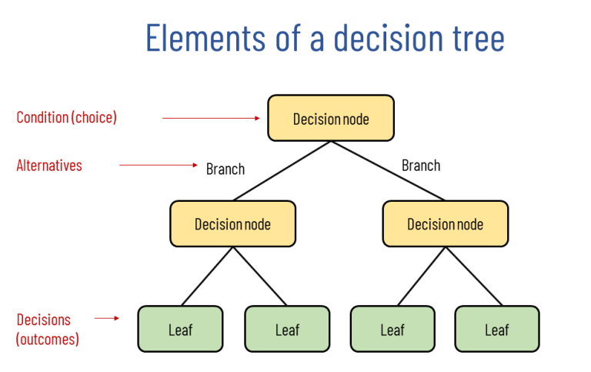
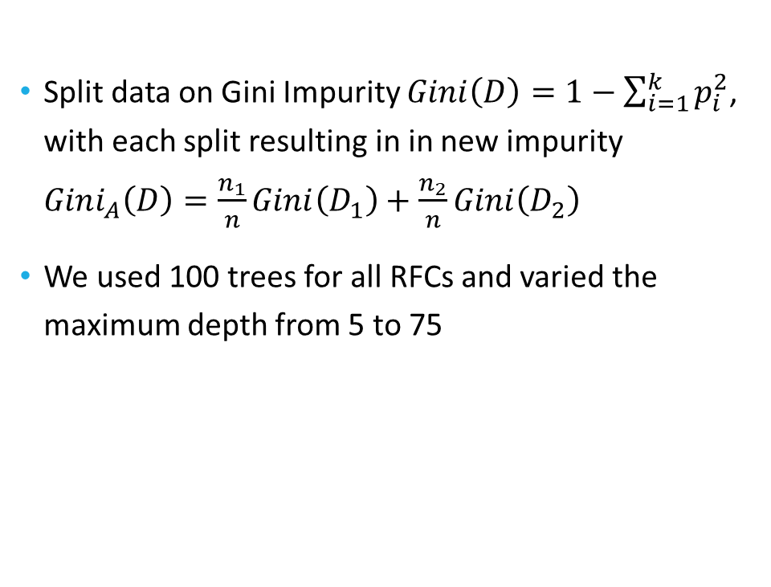
Random Forest Classifier
Split data on Gini Impurity $Gini\left(D\right)=1−\sum_{i=1}^{k}{p_{i}^{2}}$, with each split resulting in in new impurity $Gini_{A}\left(D\right)=\frac{n_{1}}{n}Gini\left(D_{1}\right)+\frac{n_{2}}{n}Gini\left(D_{2}\right)$
We used 100 trees for all RFCs and varied the maximum depth from 5 to 75

Slide 13
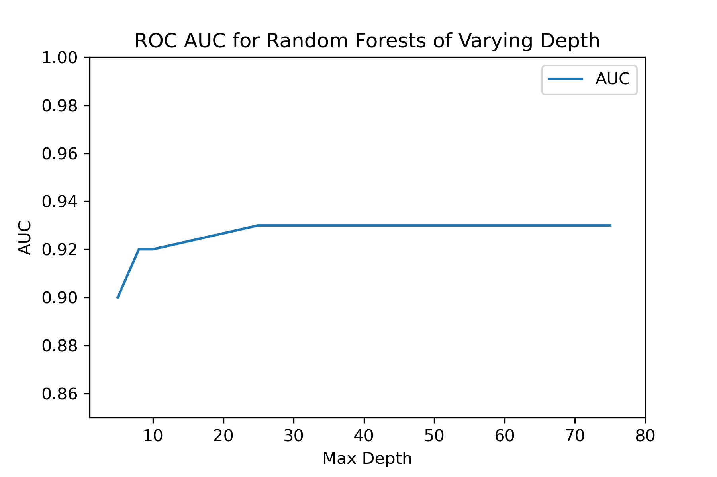
Random Forest ROC AUCs
AUC peaked at 0.93 and stayed constant from max depth of 25 up to max depth of 80
Are these models all performing the same?

Slide 14
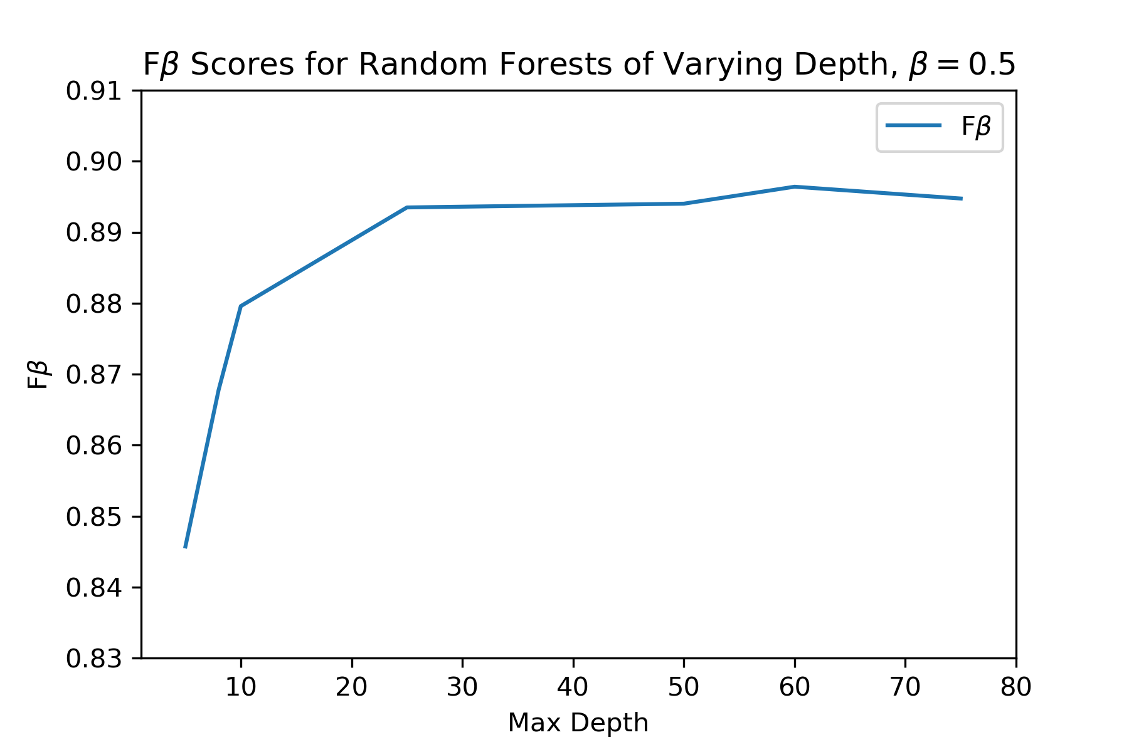
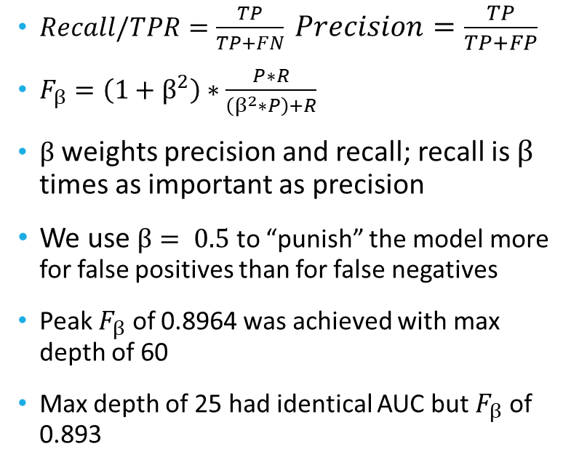
F-Scores: Better Resolution
$Recall/TPR=\frac{TP}{TP+FN} Precision=\frac{TP}{TP+FP}$
$F_{β}=\left(1+β^{2}\right)∗\frac{P∗R}{\left(β^{2}∗P\right)+R}$
$β$ weights precision and recall; recall is $β$ times as important as precision
We use $β= 0.5$ to “punish” the model more for false positives than for false negatives
Peak $F_{β}$ of 0.8964 was achieved with max depth of 60
Max depth of 25 had identical AUC but $F_{β}$ of 0.893

Slide 15
Feed-Forward Neural Network
Created in TensorFlow
One input layer, three hidden layers, and an output layer
All hidden layers used rectified linear unit activation function
Output layer used sigmoid activation function since this is binary classification
Used SGD with momentum optimizer
Batch size of 32, trained for 1000 epochs

Slide 16
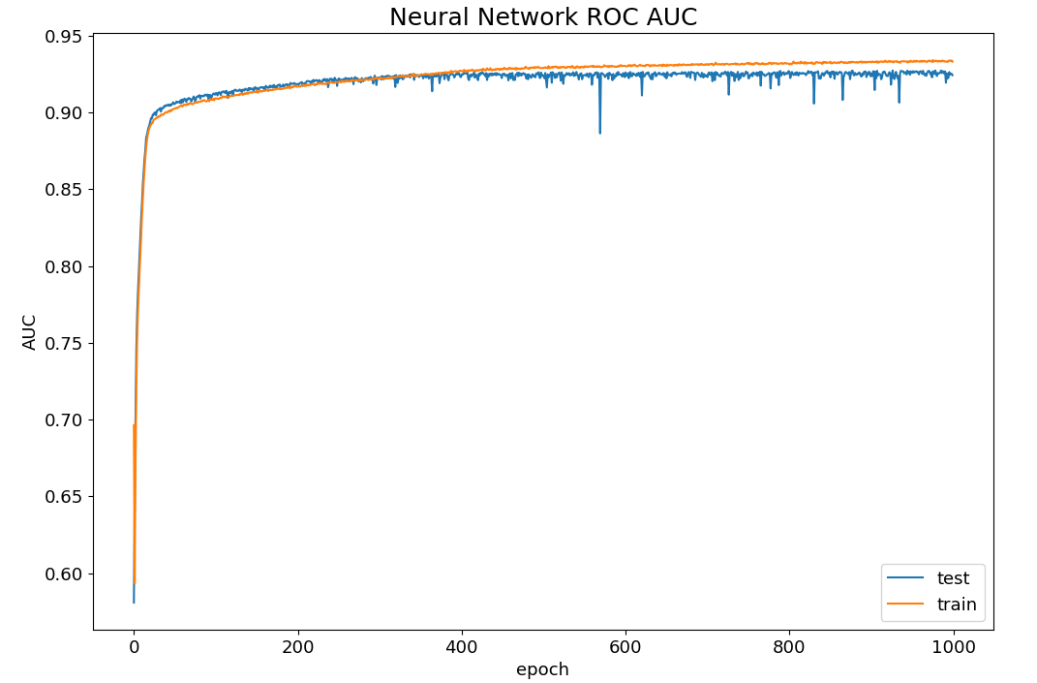
Neural Network ROC AUCs
Peak test AUC of 0.92
Mild overfitting past 400 epochs

Slide 17
Comparison of Methods
SVC with RBF kernel achieved a peak AUC of 0.90
RFC achieved a peak AUC of 0.93 at max depth of 60
Neural Network achieved a peak AUC of 0.92 after ~400 epochs of training

Slide 18
Conclusions
All 3 methods performed well; random forest and neural network performed the best
The neural network could potentially be improved with more tuning
The random forest represents best return on investment in terms of effort and simplicity

Slide 19
Acknowledgements
This dataset is the original creation of R.K. Bock, MAGIC Project, Max Planck Institute for Physics, http://wwwmagic.mppmu.mpg.de
The dataset is hosted by and accessed on the UC-Irvine Machine Learning Repository https://archive.ics.uci.edu/ml/datasets/MAGIC+Gamma+Telescope
The particle shower image on slide 5 is the work of K. Bernlöhr, Max Planck Institute for Nuclear Physics https://www.mpi-hd.mpg.de/hfm/CosmicRay/Showers.html
The decision tree image on slide 12 is the work of Y Kosarenko, https://why-change.com/2021/11/13/how-to-create-decision-trees-for-business-rules-analysis/

Slide 20
Appendix of Dataset Variables
1. fLength: continuous # major axis of ellipse [mm] 2. fWidth: continuous # minor axis of ellipse [mm] 3. fSize: continuous # 10-log of sum of content of all pixels [in #phot] 4. fConc: continuous # ratio of sum of two highest pixels over fSize [ratio] 5. fConc1: continuous # ratio of highest pixel over fSize [ratio] 6. fAsym: continuous # distance from highest pixel to center, projected onto major axis [mm] 7. fM3Long: continuous # 3rd root of third moment along major axis [mm] 8. fM3Trans: continuous # 3rd root of third moment along minor axis [mm] 9. fAlpha: continuous # angle of major axis with vector to origin [deg] 10. fDist: continuous # distance from origin to center of ellipse [mm] 11. class: g,h # gamma (signal), hadron (background)
As listed in the dataset on UCI’s Machine Learning Archive

